Slide 1
Touch Detecting Keyboard and Finger Position Display
Techblazers

Slide 2
Team Members
Emmitt Brandt
CS major
Lead
Victor Siooh
Electrical Engineering
Timekeeper
Chase Williams
Electrical Engineering
Facilitator
Chief Boateng
Computer Engineering
Project Manager
Slate Jordan
Computer Engineering
Scribe

Slide 3
Touch Typing Aid
Victor Siooh
A majority of people who do not know how to touch type look down at their keyboard when typing which can lead to:
Wasted time
Bad posture
Slows learning process
It can also be difficult for the visually impaired to see characters on the keyboard
Keyboard with on-screen display of current finger position and keys pushed

Slide 4
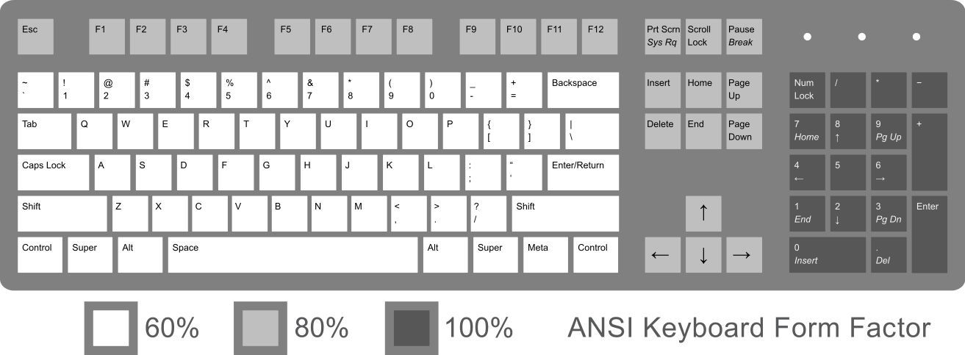
Hardware Requirements
Victor Siooh
USB 3.0 connection
Keyboard will be USB powered
QWERTY Layout
Standard keyboard layout
60% of keyboard layout key detection
Capacitive sensing for the keys that are essential for typing

Slide 5
Hardware Requirements (continued)
Victor Siooh
Capacitive Touch Sensing
Used to sense finger presence on keys
A change in capacitance in the keyboard’s capacitor detects a user’s touch
Has the advantage of no finger pressing to operate
Uninhibited normal keyboard plug and play operation
Should be able to be used as a normal keyboard without additional drivers or software

Slide 6
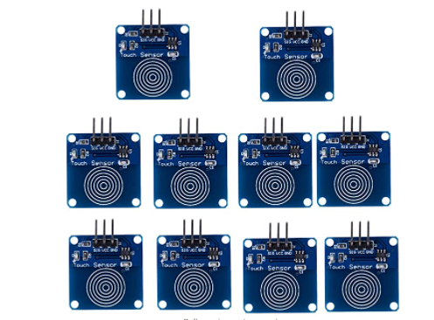
Initial Ideas for Capacitive Touch Sensing
Slate Jordan
Capacitive Touch Sensors
Utilize a capacitive touch sensors for every key
Interconnect them through multiple Arduinos
Match the layout of 60% of a keyboard
Detriments
Costs of a set of capacitive sensors and multiple arduinos
Aesthetically displeasing with too many wires
Too much risk

Slide 7
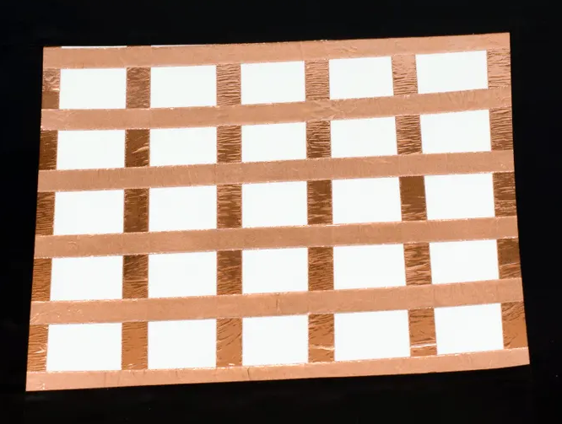
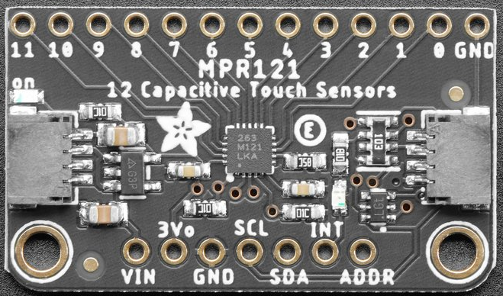
Initial Ideas for Capacitive Touch Sensing (continued)
Slate Jordan
2.) Capacitive Grid Matrix
Adafruit MPR121 12-Key Capacitive Touch Sensor Breakout will be used as the capacitive sensor includes sensitivity adjustment
Aluminum foil will be cut into strips and used to create the grid where the user’s touch will be registered
2x MPR121 will be used to specify the grid for at least 70 keys
Jumper wires will be soldered to the edge of each aluminum strip
The grid will be above the existing PCB inside the keyboard
Conductive Grid
MPR121

Slide 8
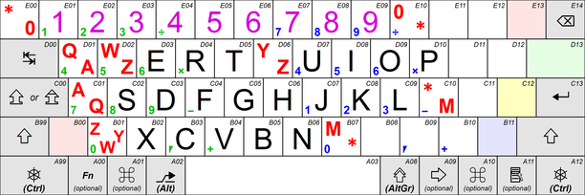
Standard ISO/IEC 9995-2
Chase Williams
Keyboard Layout
All letters and digits
Alphanumeric part of keyboard needs 47+ keys
Row 1: 12+ keys
For digits
Row 2: 12+ keys
Row 3: 11+ keys
Row 4: 10+ keys
Spacebar location

Slide 9
Software Requirements
Emmitt Brandt
Compatible with Windows 10/11 operating system
Common OS used by most students and workers
Software Coding Applications to be used
Microsoft VS Studio
Arduino IDE
Python
On-screen keyboard will be created through Python
Universal programming language
Known among team members
Display keyboard on-screen
Does not interfere with use of other applications
Remains displayed while other applications are in use
Shows keys in contact with fingers as well as which are pressed
Adjustable display
Adjustable colors/size for keys
Adjustable transparency and background

Slide 10
Iterative Software Creation
Emmitt Brandt
Break each problem down into simpler steps
Tackle each step one at a time
Test individual functions in their own context
Test integration afterwards
Helps make sure the problem’s location is known

Slide 11
Software Applications Required
Emmitt Brandt
Visual Studio Code(VS Code)
Development environment for Windows, Linux and MacOS.
Includes a development environment which makes it convenient to develop, debug and enhance code.
We would carry out the development of the code necessary for the implementation of the keyboard with capacitive keys using VS Code.
Main objective would be to develop code into an app which could display the keyboard on the screen.

Slide 12
Software Applications Required (Continued)
Chief Boateng
Arduino IDE
A development environment written with functions using c, c++ and java
Used to write and upload code to Arduino compatible boards
May require the Arduino Cloud plan(subscription plan to make use of the Arduino API)
Arduino rest API is a mechanism to exchange data between arduino and other external systems such as the arduino board
Additional Arduino components will be required which would add up to the costs(Such as the Capacitive touch sensor)
Serves as the basis as to where we bridge the link between the software aspect of the project to the hardware

Slide 13
Arduino IDE (Continued)
Chief Boateng
Program would need to be developed to detect changes in the capacitance once the user adds their finger to a specific key, to help pinpoint where a touch has occurred
Within the code, pins will be assigned to determine what pins will act as the capacitive sensors
Jumper wires will be connected to a conductive material which will be touched by the user(When the user hits a key on the keyboard)
Once The touch sensing device detects a change in capacitance after the user hits a key, an interrupt with be generated
Interrupt would alert of the change in capacitance. The touch sensing device indicates the location of the user's fingers.
This would be the data which would be displayed when the code is ran through the app developed in vscode

Slide 14
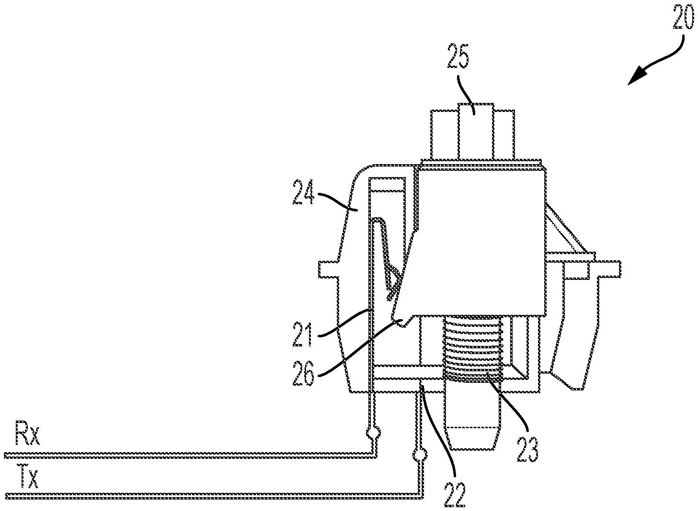
Patents
Chase Williams
Keyboard key with capacitive switch having mechanical and proximity switching functions (Moseley).
Claims:
Detects when a key is pressed
Detects when a finger approaches the key
Does not Claim:
Detects when a finger touches a keyboard key

Slide 15
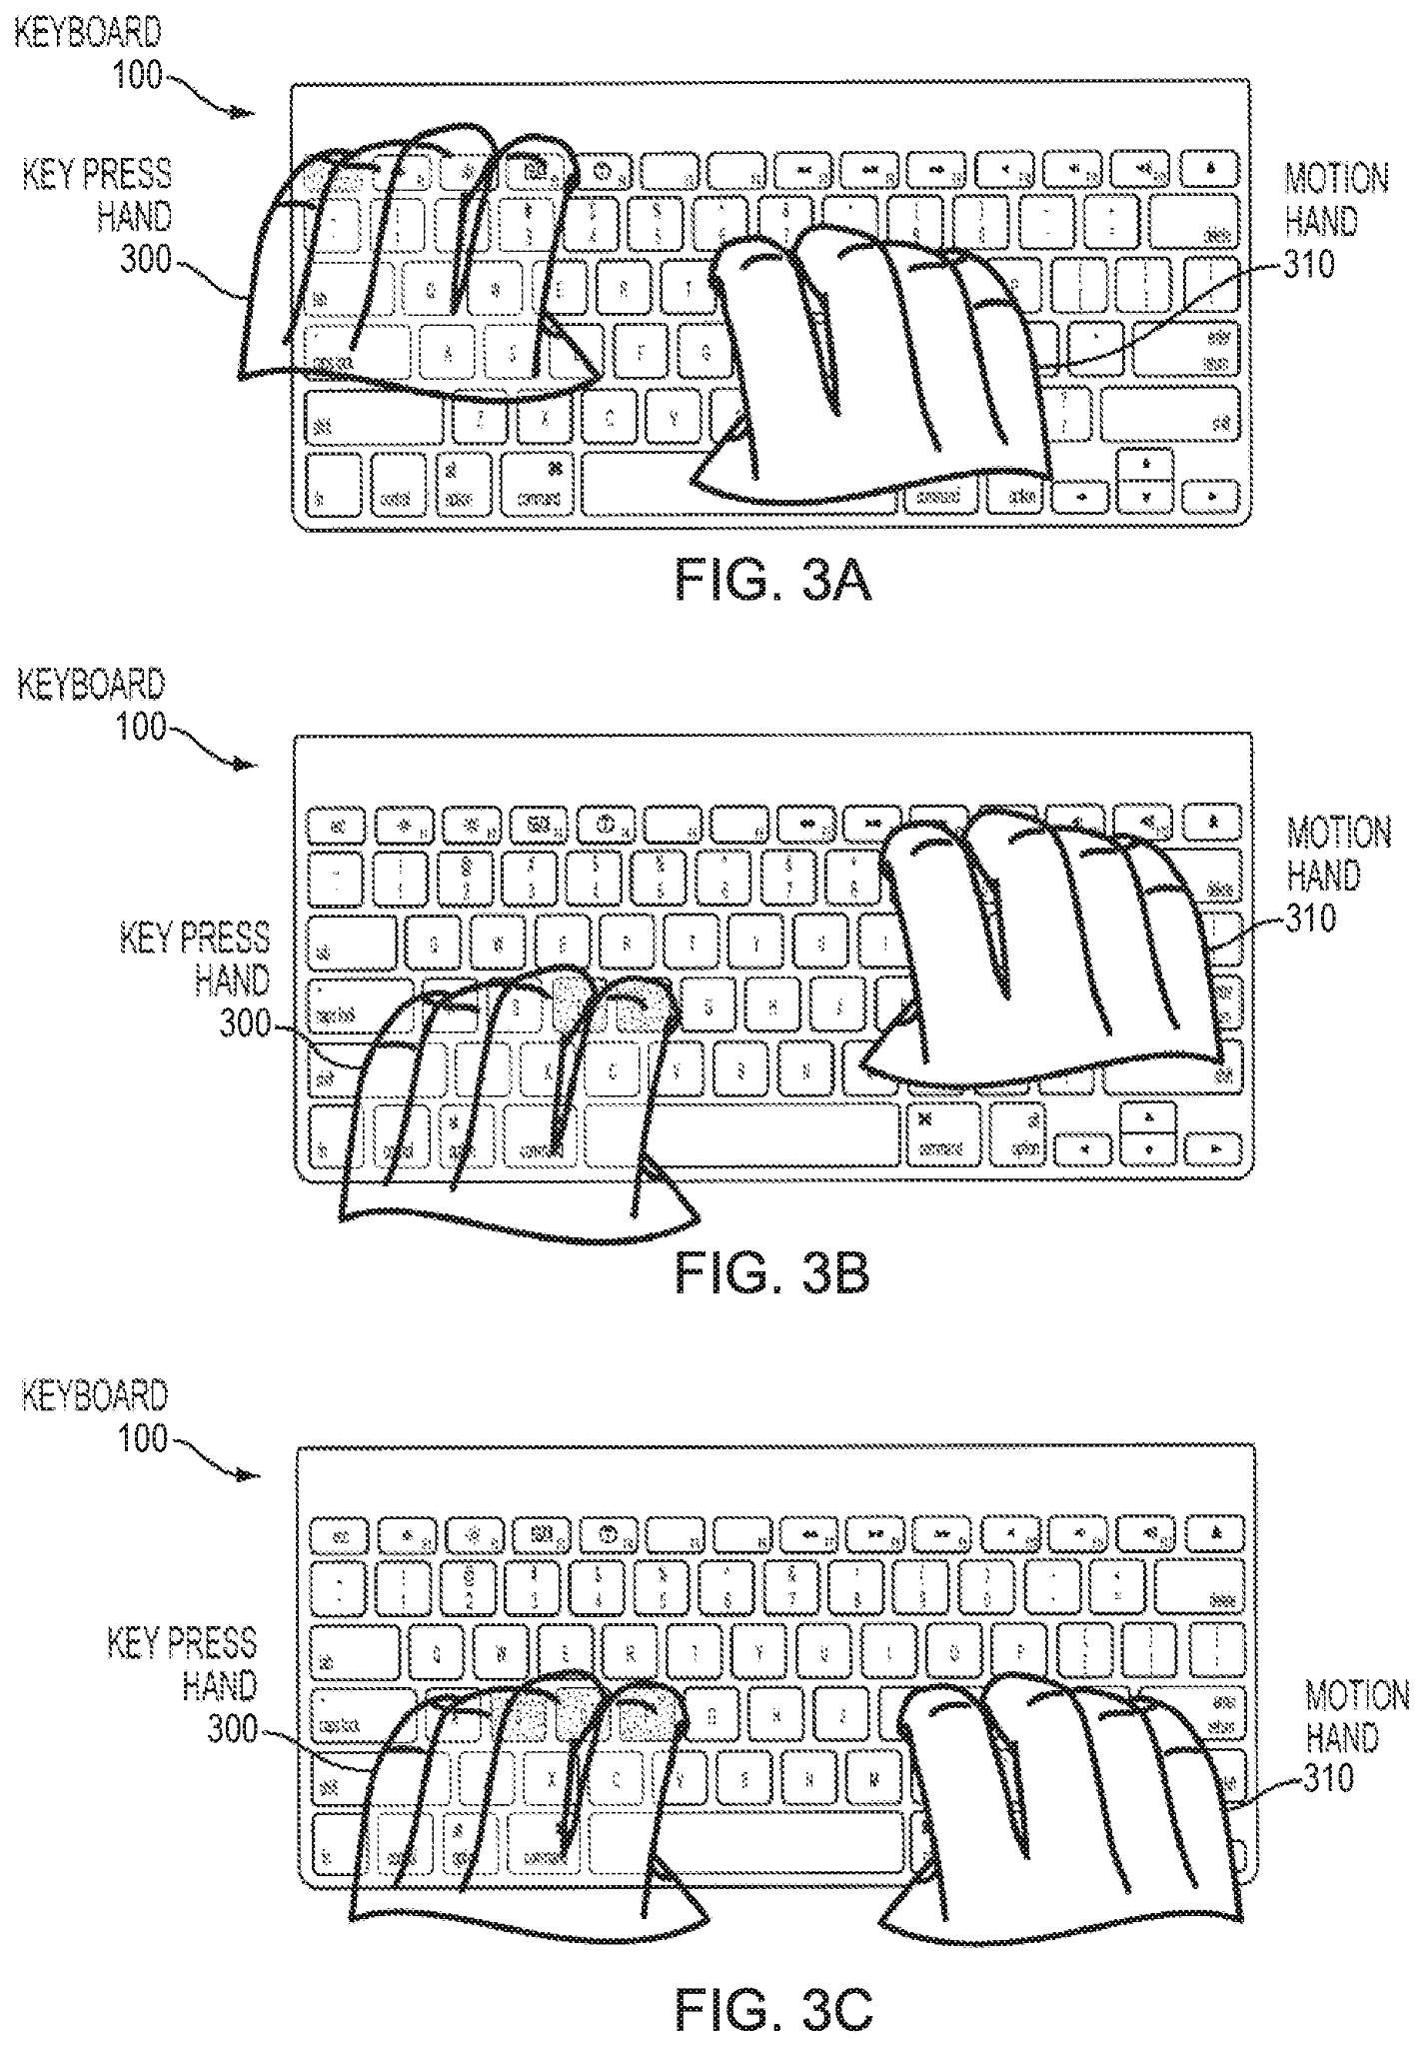
Patents Continued
Chase Williams
Touch sensitive mechanical keyboard (Elias).
Gives some of the same functionality as a mouse
Claims:
Detects objects touching capacitive sensor nodes
Detects objects proximity to capacitive sensor nodes
Detects when key is pressed
Does not (necessarily) Claim:
Detects when a finger touches a keyboard key
Depending on if we make the keys metal or put metal under the keys to detect a touch one could say an aspect of our idea is patented

Slide 16
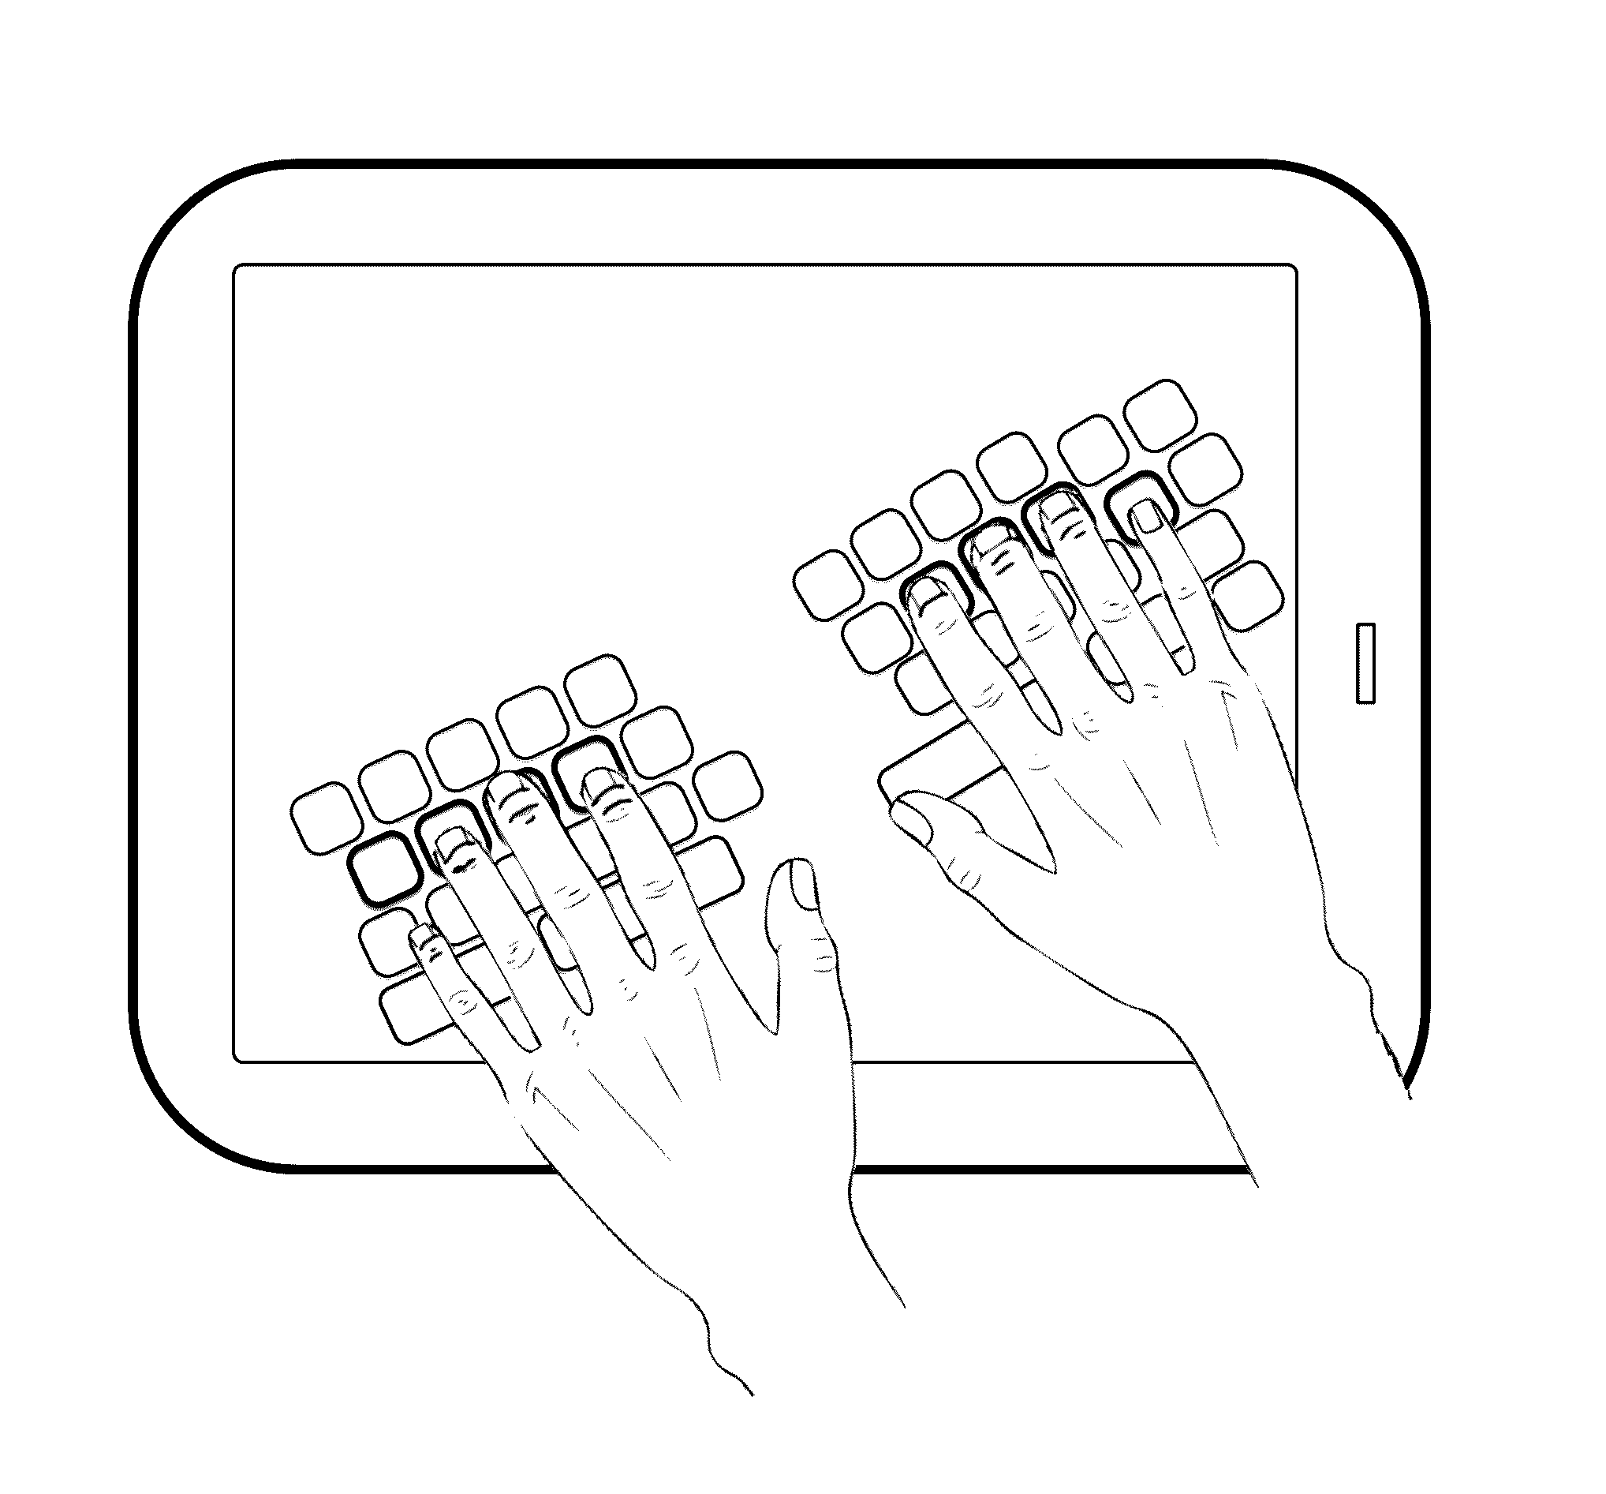
Patents Cont.
Chase Williams
Finger hover detection for improved typing (Marsden).
Allows user to type without looking at the keyboard on a smartphone/tablet
Claims:
Detects fingers hovering above a touch screen
Adjusts virtual keys to align with the user’s fingers
Does not Claim:
Detects when a finger touches a keyboard key
Displays finger positioning from a physical keyboard on a screen

Slide 17
Works Cited
Elias, John G. Touch sensitive mechanical keyboard. 15 June 2021. U.S. 11,036,307. USPTO, https://patft.uspto.gov/netacgi/nph-Parser?Sect1=PTO2&Sect2=HITOFF&u=%2Fnetahtml%2FPTO%2Fsearch-adv.htm&r=1&f=G&l=50&d=PALL&p=1&S1=11036307&OS=11036307&RS=11036307.
ISO. Information technology — Keyboard layouts for text and office systems — Part 2: Alphanumeric section. ISO/IEC 9995-2:2009, ISO, October 2009.
Marsden, Randal J, et al. Finger hover detection for improved typing. 8 Nov. 2016. U.S. 9,489,086. USPTO, https://patft.uspto.gov/netacgi/nph-Parser?Sect1=PTO1&Sect2=HITOFF&p=1&u=/netahtml/PTO/srchnum.html&r=1&f=G&l=50&d=PALL&s1=9489086.PN.
Moseley, Braon. Keyboard key with capacitive switch having mechanical and proximity switching functions. 18 May 2021. U.S. 11,012,069. USPTO, https://patft.uspto.gov/netacgi/nph-Parser?Sect1=PTO1&Sect2=HITOFF&p=1&u=/netahtml/PTO/srchnum.html&r=1&f=G&l=50&d=PALL&s1=11012069.PN.

